Slide 1
EVADC Timing
19 May 2021

Slide 2
ADC signal Details
AFC | DABP | DABS | Control Board
VAC1_SNS_PM1IN | VAC1_SNS_PM2IN | VAC1_SNS_PM3IN | AMB_SENSE_1
VAC2_SNS_PM1IN | VAC2_SNS_PM2IN | VAC2_SNS_PM3IN | AMB_SENSE_2
VAC3_SNS_PM1IN | VAC3_SNS_PM2IN | VAC3_SNS_PM3IN
VDC_SNS_PM1IN | VDC_SNS_PM2IN | ILEG1_SNS_PM3IN
IPH1_SNS_PM1IN | ILEG1_SNS_PM2IN | ILEG2_SNS_PM3IN
IPH2_SNS_PM1IN | ILEG2_SNS_PM2IN | ILEG3_SNS_PM3IN
IPH3_SNS_PM1IN | ILEG3_SNS_PM2IN | IPH1_SNS_PM3IN
ILEG1_SNS_PM1IN | IPH1_SNS_PM2IN | IPH2_SNS_PM3IN
ILEG2_SNS_PM1IN | IPH2_SNS_PM2IN | IPH3_SNS_PM3IN
ILEG3_SNS_PM1IN | IPH3_SNS_PM2IN | TEMP_HS_SNS_PM3IN
TEMP_HS_SNS_PM1IN | TEMP_HS_SNS_PM2IN | TEMP_PCB_SNS_PM3IN
TEMP_PCB_SNS_PM1IN | TEMP_PCB_SNS_PM2IN | TEMP_LEG1_SNS_PM3IN
TEMP_LEG1_SNS_PM1IN | TEMP_LEG1_SNS_PM2IN | TEMP_LEG2_SNS_PM3IN
TEMP_LEG2_SNS_PM1IN | TEMP_LEG2_SNS_PM2IN | TEMP_LEG3_SNS_PM3IN
TEMP_LEG3_SNS_PM1IN | TEMP_LEG3_SNS_PM2IN | 24V_SNS_PM3IN
24V_SNS_PM1IN | 24V_SNS_PM2IN | VDC_SNS_PM3IN
 |  | CUR_SNS
Total count 51

Slide 3
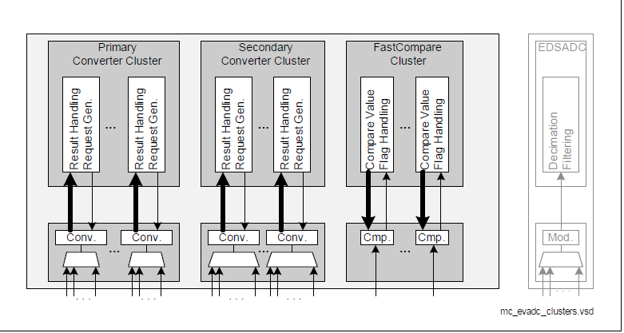
Aurix ADC Architecture
Primary converter cluster - 8 Stage queue - conversion time below 0.5us
Secondary Converter cluster– 16 stage queue – conversion time below 1us
Each group has individual converter, it will work concurrently
8 groups in Tc377 ( 8 converters in total)

Slide 4
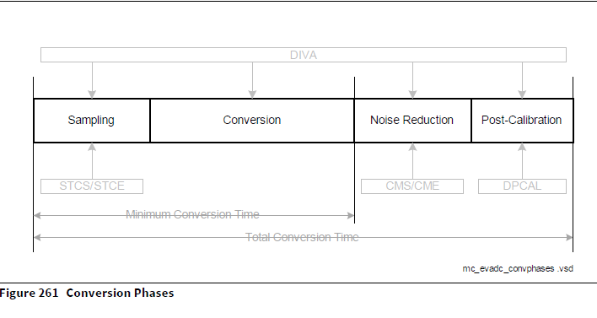
Total Conversion Time
ADC Maximum frequency 20Mhz
Sample time minimum 100ns
Result generation time 650ns
Minimum time of conversion without post calibration is 768.75ns (single channel)

Slide 5
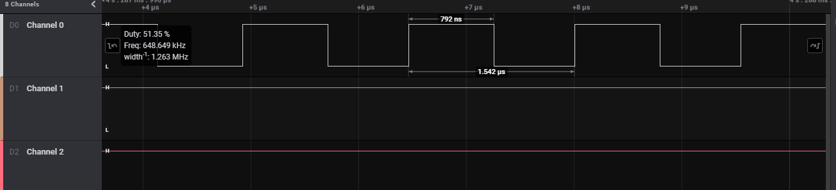
Primary Channel
Sample time 100ns – primary channel
Each conversion to result generation takes 792ns for single channel

Slide 6
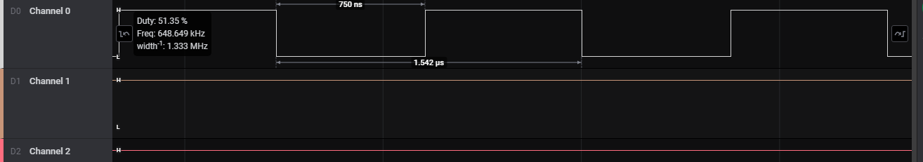
Secondary Channel
Sample time 100ns – secondary cluster Channel
Each conversion to result generation takes 750ns for single channel

Slide 7
Closed Loop Channel Configuration
Each group has 3 queue with respective stages
Using that queue we can configure the priority of the channel
ADC has 4 priority (highest, high, low, lowest)
Group 0 and Group 1 converter dedicated to closed loop
Sample Timing of 500ns
Every 5.2us all 7 channel will get converted
Closed Loop Channel
Group 0 | Group 1
VAC1_SNS_PM1IN | IPH1_SNS_PM1IN
VAC2_SNS_PM1IN | IPH2_SNS_PM1IN
VAC3_SNS_PM1IN | IPH3_SNS_PM1IN
 | VDC_SNS_PM3IN

Slide 8
Fault Detection Channels
Remaining Channel in current pin mapping
Configure the channel priority to reduce the conversion timing
Group 8 | Group 9 | Group 11 | Group 3
TEMP_PCB_SNS_PM1IN | IPH1_SNS_PM2IN | ILEG1_SNS_PM1IN | AMB_SENSE_1
TEMP_LEG1_SNS_PM1IN | IPH2_SNS_PM2IN | ILEG2_SNS_PM1IN | 1
TEMP_LEG2_SNS_PM1IN | IPH3_SNS_PM2IN | ILEG3_SNS_PM1IN
TEMP_LEG3_SNS_PM1IN | TEMP_HS_SNS_PM2IN | TEMP_HS_SNS_PM1IN
24V_SNS_PM1IN | TEMP_PCB_SNS_PM2IN | ILEG1_SNS_PM3IN
VAC1_SNS_PM2IN | TEMP_LEG1_SNS_PM2IN | ILEG2_SNS_PM3IN
VAC2_SNS_PM2IN | TEMP_LEG2_SNS_PM2IN | ILEG3_SNS_PM3IN
VAC3_SNS_PM2IN | TEMP_LEG3_SNS_PM2IN | IPH1_SNS_PM3IN
VDC_SNS_PM2IN | 24V_SNS_PM2IN | IPH2_SNS_PM3IN
ILEG1_SNS_PM2IN | VAC1_SNS_PM3IN | IPH3_SNS_PM3IN
ILEG2_SNS_PM2IN | VAC2_SNS_PM3IN | TEMP_HS_SNS_PM3IN
ILEG3_SNS_PM2IN | VAC3_SNS_PM3IN | TEMP_PCB_SNS_PM3IN
12 | AMB_SENSE_2 | TEMP_LEG1_SNS_PM3IN
 | CUR_SNS | TEMP_LEG2_SNS_PM3IN
 | 14 | TEMP_LEG3_SNS_PM3IN
 |  | 24V_SNS_PM3IN
 |  | 16
We can configure either G11 or G2,G3

